Slide 1

Knowledge Graph Completion with Adaptive
Sparse Transfer Matrix

Slide 2
Keywords
◆ Knowledge Graph Completion
◆ Adaptive Sparse Matrix
◆ heterogeneity + imbalance
◆ Structured and Unstructured patterns
◆ TranSparse(share) + TranSparse(separate)
◆ Triplet Classification + Link Prediction

Slide 3
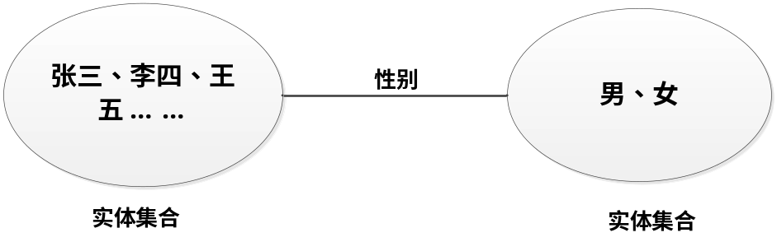
Problems
1、heterogeneity（异质性、不均匀性）
2、imbalance（不平衡性）
Relation:
性别：200000条
电影代表作：500条
不均匀性
不平衡性

Slide 4
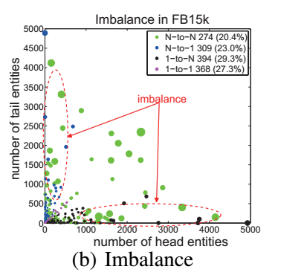
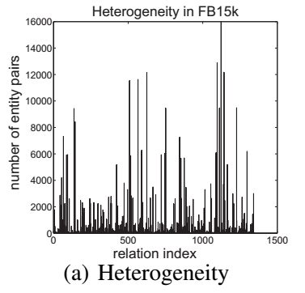
Relation statistic of FB15k which
contains 1345 relations
Each circle represents a relation

Slide 5
heterogeneity（异质性、不均匀性）
◆ overfitting on simple relations
◆ underfitting on complex relations
imbalance（不平衡性）
◆ 不合理，关系两边的实体数目差距大

Slide 6
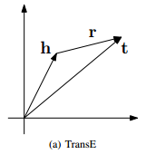
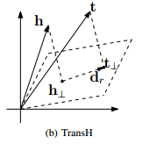





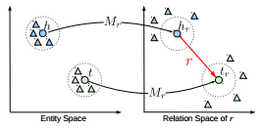

Related Work
TransE
model：
score function：
TransH
model：
score function：
TransR
model：
score function：
Other Methods
TransD
KG2E
SE
ME
....
上述方法都没有考虑到异质性和不平衡性！

Slide 7
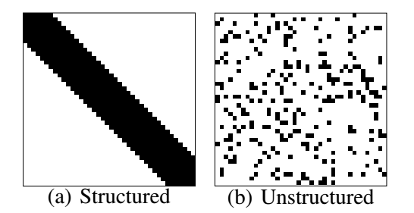
Our Model
(1) Sparse Matrix
特点：容易压缩，占用存储空间少，只有非零元素参与运算，计算量小。
sparse degree：0元素的个数 / 矩阵中所有元素的数目
有结构的模式能够使模型更加容易地按比例扩大知识图谱。而无结构化的模式相比有结构的模式实验结果更好。
the structured pattern is conductive to matrix by-vector products, but the unstructured is not.

Slide 8
(2) Sparse Matrix vs Low-Rank Matrix
◆ degrees of freedom: the number of variates which are independence
◆ complex relation: high degrees of freedom
◆ simple relation: low degrees of freedom
◆ two reasons:
Sparse Matrix is more flexible than Low-Rank Matrix
Sparse Matrix is more efficient than Low-Rank Matrix
a、计算量小
b、更容易扩大知识图谱

Slide 9
(3) TranSparse
1、TranSparse（share）
a、针对heterogeneity这个特性，share表示的是共用同一个转换矩阵
b、以前的方法中对于复杂或简单关系参数数目相同
c、complex relations需要更多的参数
d、simple relation需要的参数要少一些
◆ sparse degree：
◆ projected vector:

Slide 10

2、TranSparse（separate）
◆ we set two separate sparse matrix for each relation, one for head
and the other for tail.
◆ sparse degree:
◆ projected vector:
◆ score function:

Slide 11

(3) Training Objective
◆ positive:
◆ negative:
◆ Knowledge graphs only encode positive training triplet, they do not contain negative examples.
unif
bern
◆
◆ margin-based ranking loss:

Slide 12
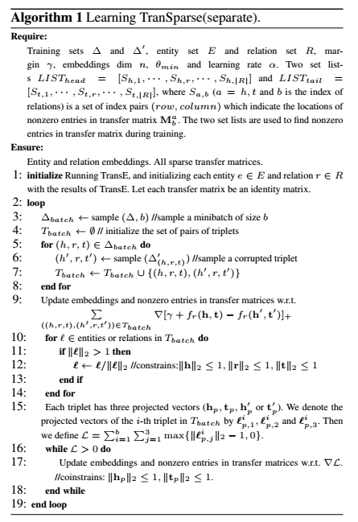
(4) Algorithm Implementation
◆ nz
◆ nz'= nz - n

Slide 13
Thank you!

